Slide 1

Analysis of Cyclist Counts At East River Bridge Locations
Weichen li
Notes:
To keep count of cyclists entering and leaving Queens, Manhattan and via East River Bridges. The Traffic Information Management System (TIMS) collects the count data.

Slide 2
Data
Date | High Temp (°F) | Low Temp (°F) | Precipitation | Brooklyn Bridge | Manhattan Bridge | Williamsburg Bridge | Queensboro Bridge | Total
2019/4/1 | 48.2 | 33.8 | 0 | 1,544 | 3,774 | 3,946 | 2,879 | 12,143
2019/4/2 | 50 | 41 | 0 | 1,459 | 4,579 | 4,502 | 3,457 | 13,997
2019/4/3 | 62.6 | 42.8 | 0 | 2,041 | 5,580 | 5,702 | 3,977 | 17,300
2019/4/4 | 57.2 | 44.6 | 0 | 2,141 | 5,309 | 5,423 | 4,105 | 16,978
2019/4/5 | 46.4 | 37.4 | 0.2 | 610 | 1,893 | 2,262 | 1,958 | 6,723
Notes:
NYC DOT

Slide 3
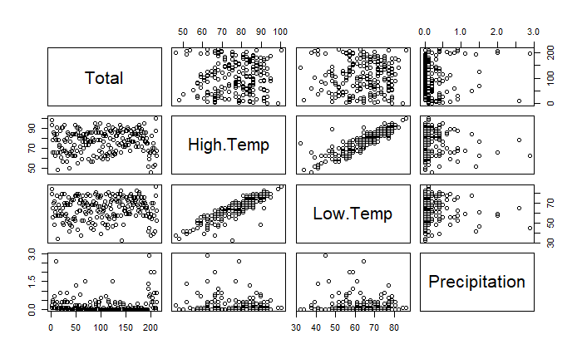
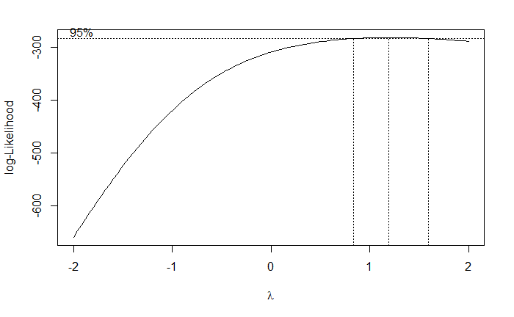
Numerical Variables
Notes:
Correlation Box Cox linearly corelated by the large

Slide 4
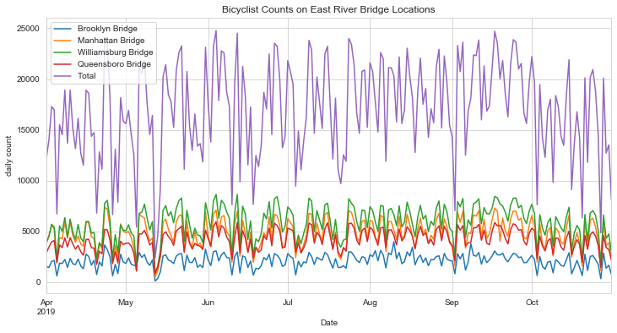
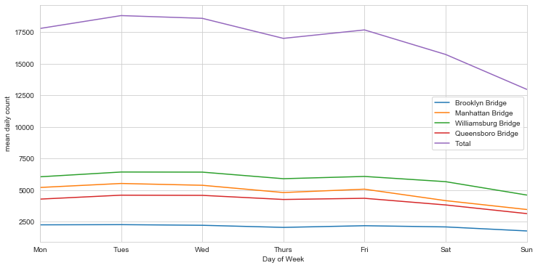
Dummy Variable
Notes:
Observe Periodical change
the mean of cyclist counts seems to be different among different day of week

Slide 5
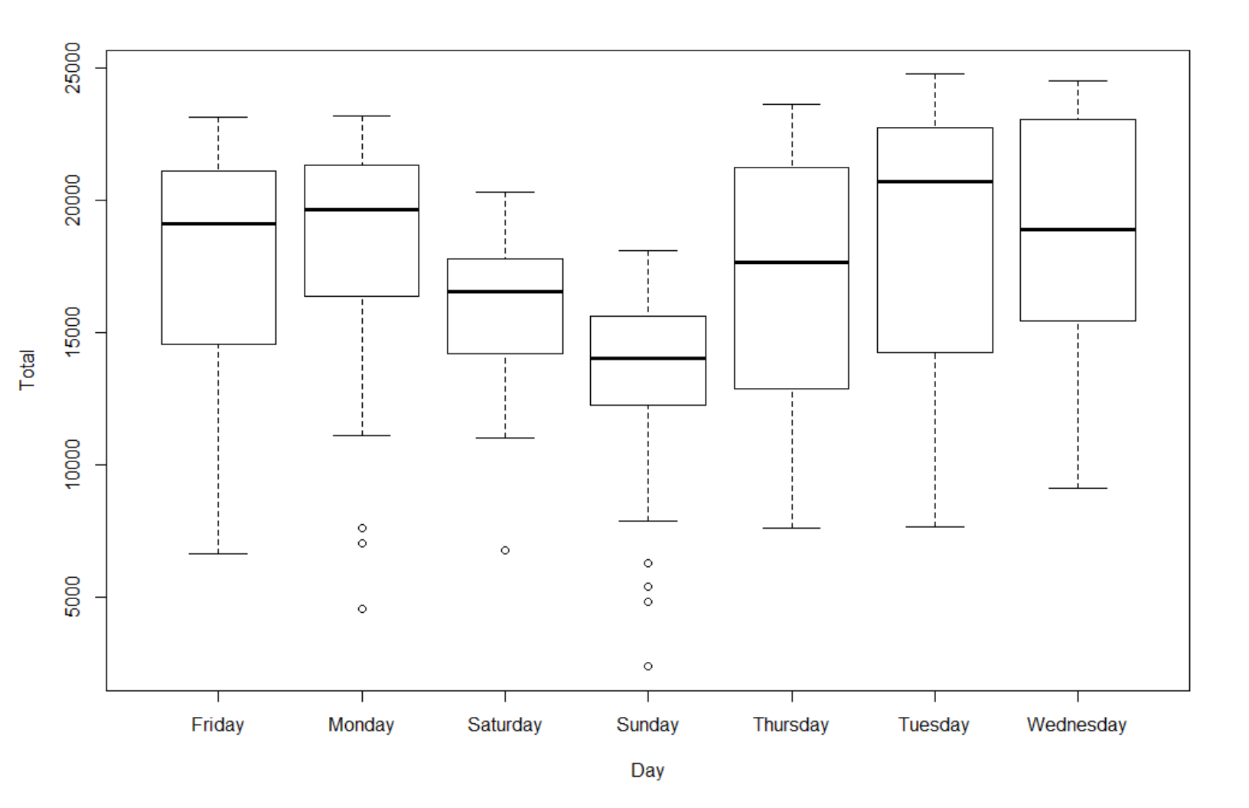
Dummy Variable
Difference?
Each day of week?
Weekdays and weekends?
Notes:
From the boxplot, there are less cyclists at weekends. So should we construct some dummy variables? If so, it should be based on day of week or

Slide 6
Dummy Variable
NH:μ1= μ2= μ3= μ4= μ5= μ6= μ7
Model 1: Total ~ 1
Model 2: Total ~ 0 + Day
Res.Df RSS Df Sum of Sq F Pr(>F)
1 213 4846732741
2 207 4099246022 6 747486720 6.291 4.305e-06
NH:μ1= μ2= μ3= μ4= μ5, μ6= μ7
Model 1: Total ~ 0 + Weekend
Model 2: Total ~ 0 + Day
Res.Df RSS Df Sum of Sq F Pr(>F)
1 212 4279899964
2 207 4099246022 5 180653943 1.8245 0.1094
NH:μ1= μ2= μ3= μ4= μ5
Model 1: Total ~ Sunday + Saturday
Model 2: Total ~ 0 + Day
Res.Df RSS Df Sum of Sq F Pr(>F)
1 211 4165464780
2 207 4099246022 4 66218759 0.836 0.5037
Different?
Each day of week?
Weekdays and weekends?
Tukey multiple comparisons of means
95% family-wise confidence level
Fit: aov(formula = Total ~ weekfactor, data = bicycle)
diff lwr upr p adj
sunday-saturday -2762.067 -5469.9221 -54.21125 0.0444270
weekday-saturday 2242.217 149.2665 4335.16814 0.0325047
weekday-sunday 5004.284 2911.3332 7097.23481 0.0000002
Notes:
Apparently, cyclist counts are different among different day of a week. It’s suggestive but inconclusive that there are some differences in weekdays or in weekends. On the one hand, in weekdays, we can’t reject the NH that means of cyclist counts in different weekdays are the same. On the other hand, the difference of cyclists counts between Sunday and Saturday shouldn’t be ignored. So we would have 3 categories(weekdays, Saturday, Sunday) .we would need 2 dummy variables.

Slide 7
Model & Prediction
By Stepwise AIC backward regression:
lm(formula = Total ~ High.Temp + Precipitation + Sunday + Saturday, data = bicycle)
Estimate Std. Error t value Pr(>|t|)
(Intercept) 8684.92 1715.76 5.062 9.09e-07 ***
High.Temp 134.31 21.87 6.141 4.08e-09 ***
Precipitation -5123.59 588.92 -8.700 9.93e-16 ***
Sunday -4777.09 701.94 -6.806 1.04e-10 ***
Saturday -2602.79 699.69 -3.720 0.000256 ***
Residual standard error: 3499 on 209 degrees of freedom
Multiple R-squared: 0.4719, Adjusted R-squared: 0.4618
F-statistic: 46.69 on 4 and 209 DF, p-value: < 2.2e-16
Total= 8684.92+ 134.31*High.Temp-5123.59*Precipitation-2602.79*Saturday-4777.09*Saturday
Specifically:
Williamsburg.Bridge=2724.986+49.572*High.Temp-1778.629
*Precipitation-1495.640*Sunday-641.913*Saturday
...
Notes:
Weather forecast
via the East River Bridges

